Slide 1


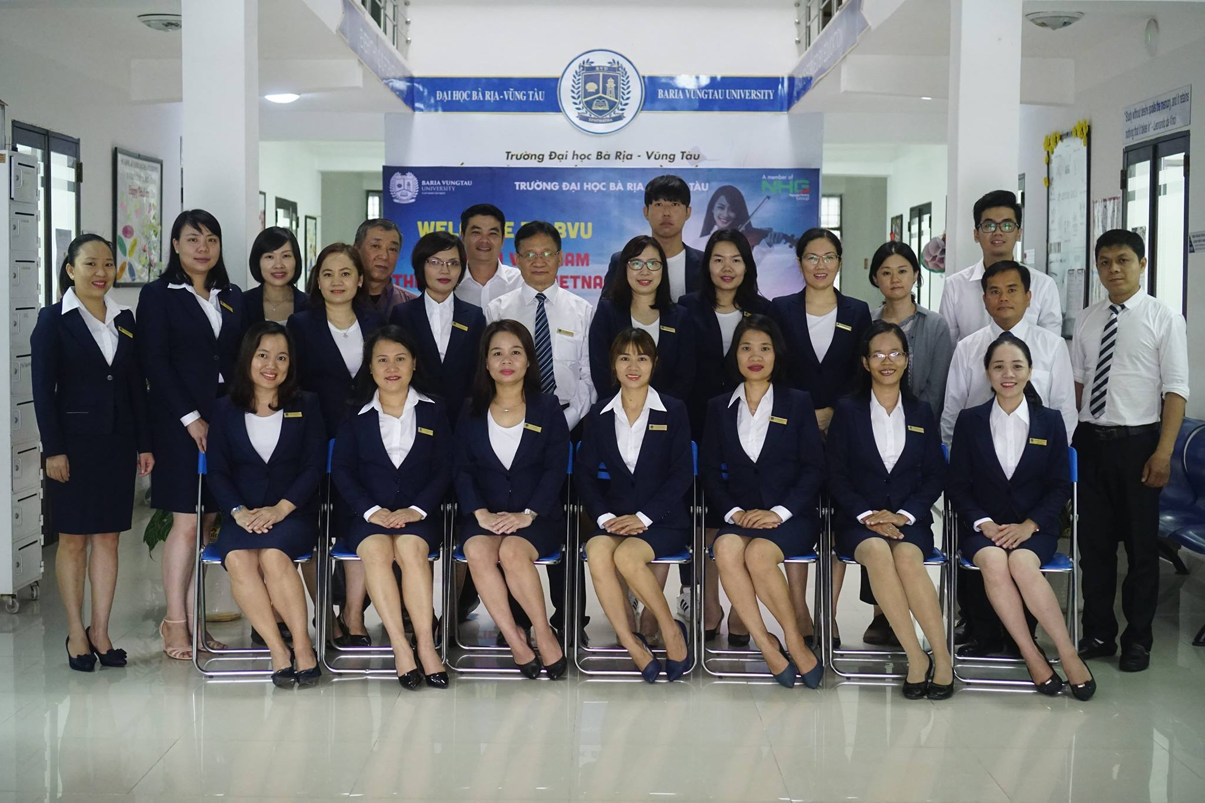

Slide 2
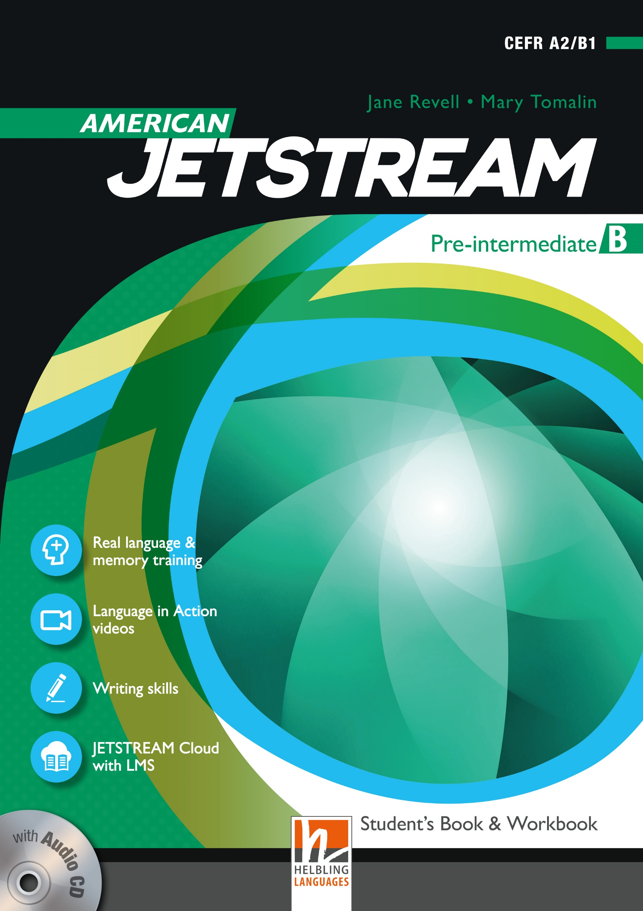
AMERICAN JETSTREAM PRE-INTERMEDIATE B

Slide 3
TEACHER’S PERSONAL INFORMATION
Name: Nguyen Thanh Loan
Facebook: Loan Nguyễn Thanh
Mobile number: 0942 255 937
Email: loannguyenthanh1978@gmail.com

Slide 4
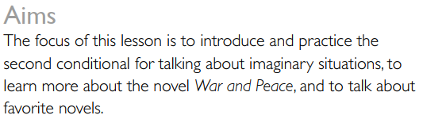
UNIT 11
Artists and writers
LESSON 2
If I took one novel……..

Slide 5

VOCABULARY
Bookshelf blog
discs
/dɪsk/
a thin flat round object
Ex: This disc contains lots of extra features, including an interview with the director.

Slide 6

VOCABULARY
Bookshelf blog
guest
/ɡest/
a person that you have invited to your house or to a particular event that you are paying for
Ex: They invited six guests to their house for dinner.

Slide 7

VOCABULARY
Bookshelf blog
luxury
ˈlʌkʃəri/
a thing that is expensive and pleasant but not essential
Ex: they are rich so they always wear luxury items.

Slide 8

VOCABULARY
Bookshelf blog
publish
/ˈpʌblɪʃ/
to print a letter, an article, etc. in a newspaper or magazine
Ex: The editors published a full apology in the following edition.

Slide 9
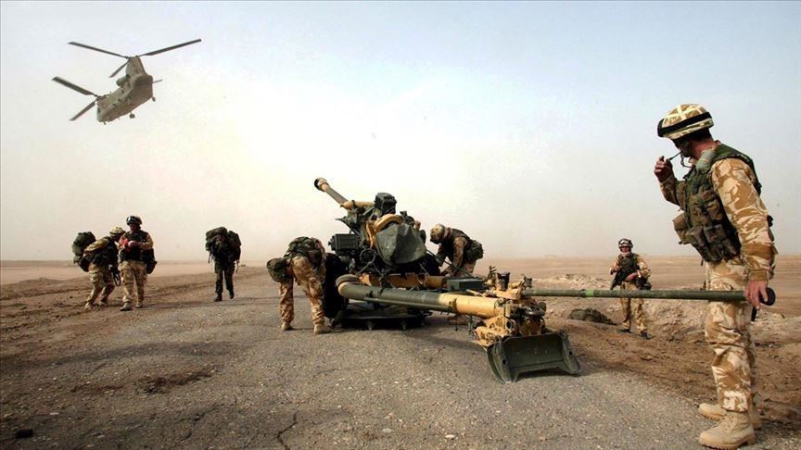
VOCABULARY
Bookshelf blog
invasion
/ɪnˈveɪʒn/
the act of an army entering another country by force in order to take control of it
Ex: The invasion force comprised 3 000–5 000 heavily armed troops.

Slide 10

VOCABULARY
Bookshelf blog
character
/ˈkærəktə(r)/
a person or an animal in a book, play or film
Ex: They are the characters in film “Sunflowers against the sun”.

Slide 11
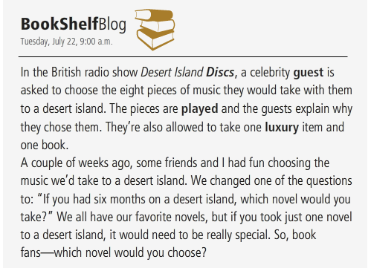
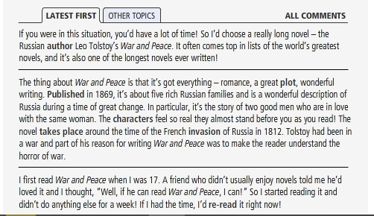
READING
If I took one novel……..

Slide 12
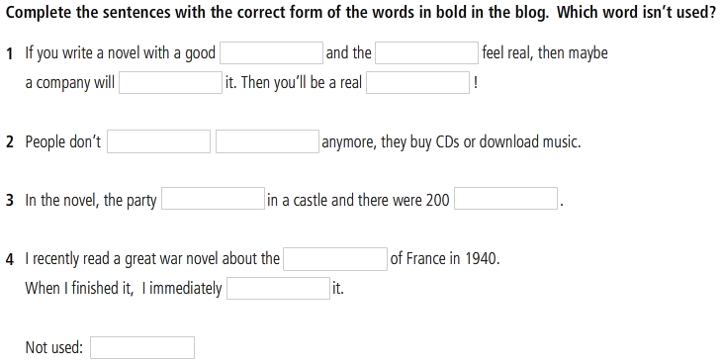
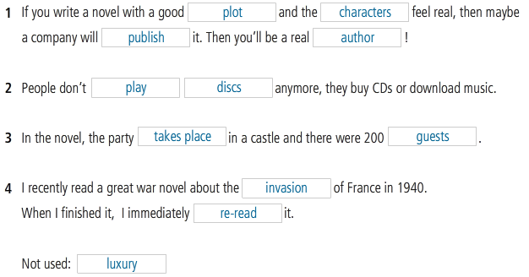
READING
If I took one novel……..

Slide 13
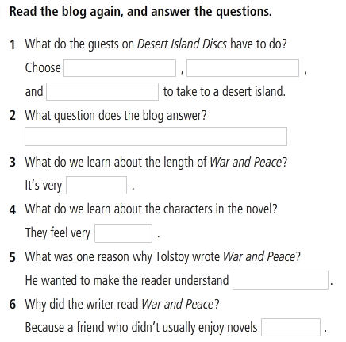
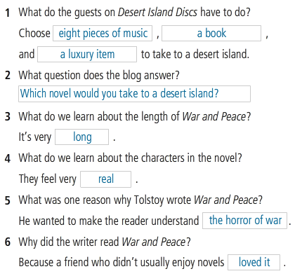

Slide 14
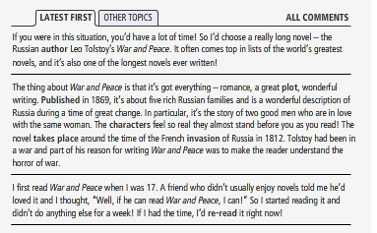
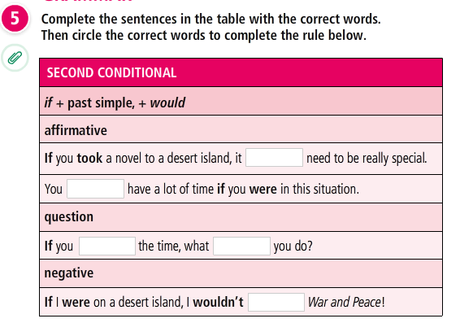
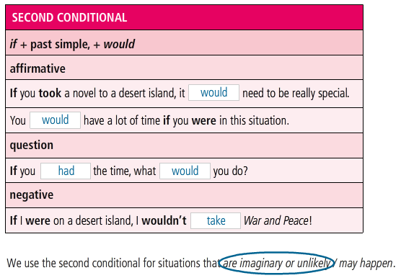
READING
If I took one novel……..

Slide 15
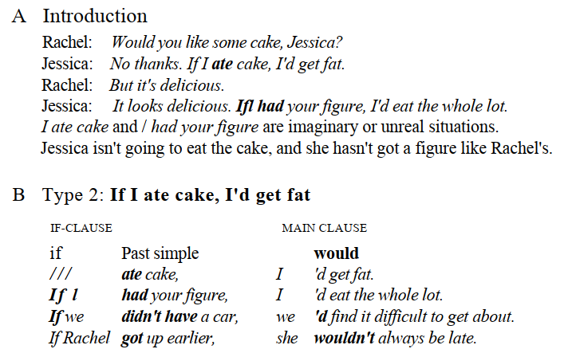
GRAMMAR
Second conditional

Slide 16
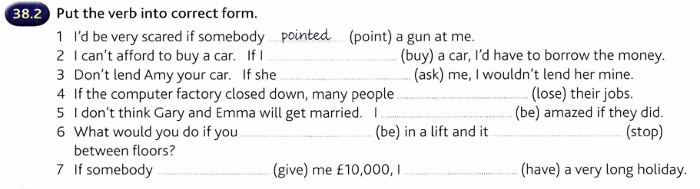
GRAMMAR
Second conditional

Slide 17
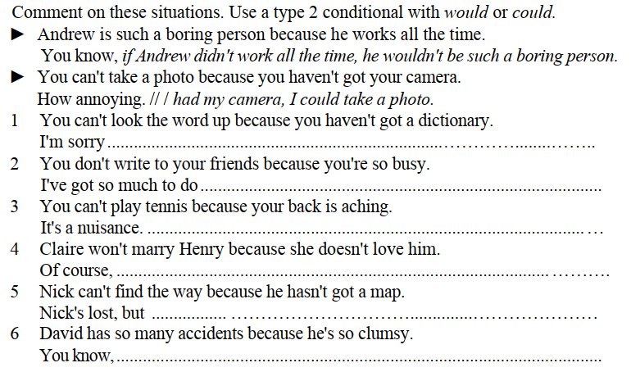
GRAMMAR
Second conditional

Slide 18
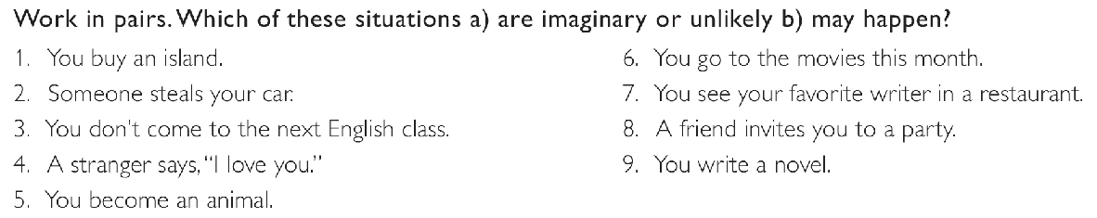
SPEAKING
Write sentences about the situations. Use either the first or second conditional

Slide 19
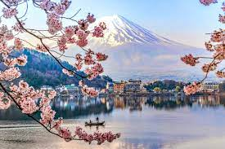
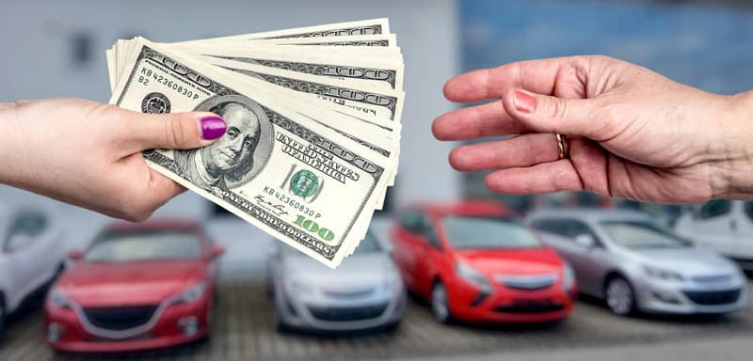
Second conditional
SPEAKING
Make a list of things you do for the following question.
What would you do if you had a lot of time?
Ex: If I had a lot of time, I’d travel to Japan.
What would you do if you had a lot of money?
Ex: If I had a lot of money, I’d buy a new car.

Slide 20

WRITING
My favorite novel
One of my favorite novel is “One Hundred Years of Solitude” which is a widely beloved and acclaimed novel known throughout the world, and the ultimate achievement in a Nobel Prize–winning career. The novel tells the story of the rise and fall of the mythical town of Macondo through the history of the Buendía family. It is a rich and brilliant chronicle of life and death, and the tragicomedy of humankind. In the noble, ridiculous, beautiful, and tawdry story of the Buendía family, one sees all of humanity, just as in the history, myths, growth, and decay of Macondo, one sees all of Latin America. Love and lust, war and revolution, riches and poverty, youth and senility — the variety of life, the endlessness of death, the search for peace and truth — these universal themes dominate the novel. Whether he is describing an affair of passion or the voracity of capitalism and the corruption of government, Gabriel García Márquez always writes with the simplicity, ease, andpurity that are the mark of a master. Alternately reverential and comical, One Hundred Years of Solitude weaves the political, personal, and spiritual to bring a new consciousness to storytelling. Translated into dozens of languages, this stunning work is no less than an accounting of the history of the human race.

Slide 21
REFERENCES
Grammar: Second conditional
https://www.youtube.com/watch?v=iZnL2cb_w20
Speaking: Books
https://www.youtube.com/watch?v=cnFUwu-jLNI
Speaking: Films
https://www.youtube.com/watch?v=4uerFSSBhko

